Slide 1










Exploratory Data Analysis - Sports
on
Indian Premier League

Slide 2

Contents
Project Description
Analysis Dashboard
Outcome/Findings
Statistical verification of the outcome

Slide 3
Project Description
Perform EDA on Indian Premier League dataset containing 2 .csv files (deliveries & matches) by analysing the data and identifying the most successful player, team & its contributing factors.
Suggest a team (or) player a company should endorse for its products.

Slide 4
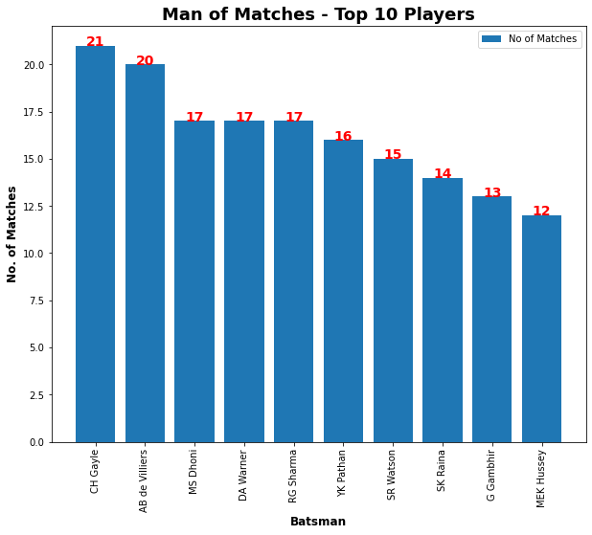
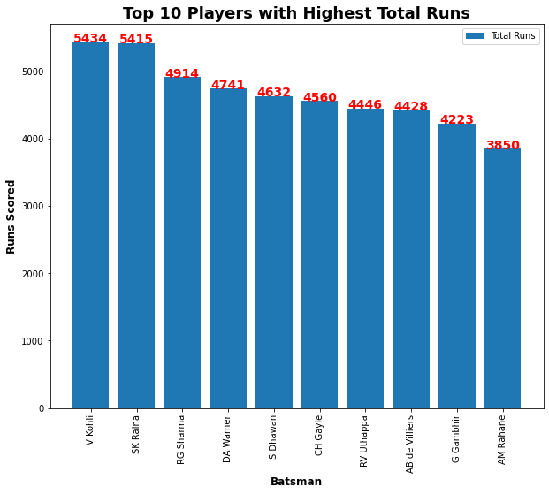
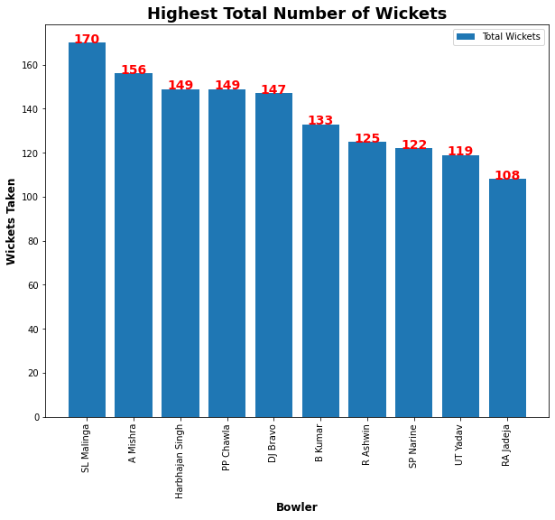
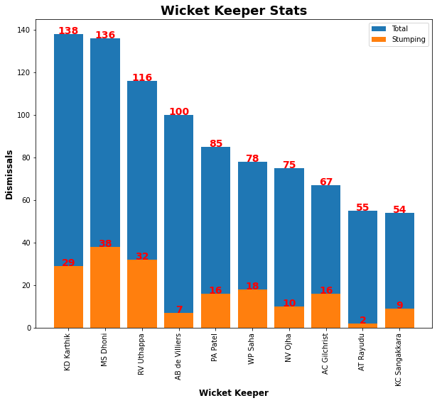
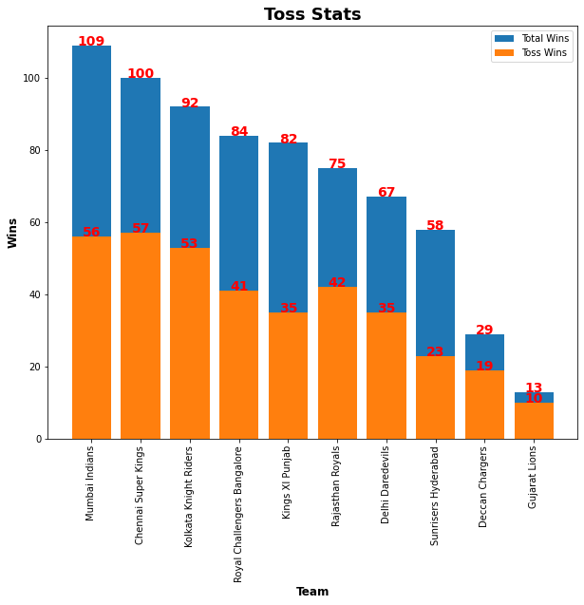
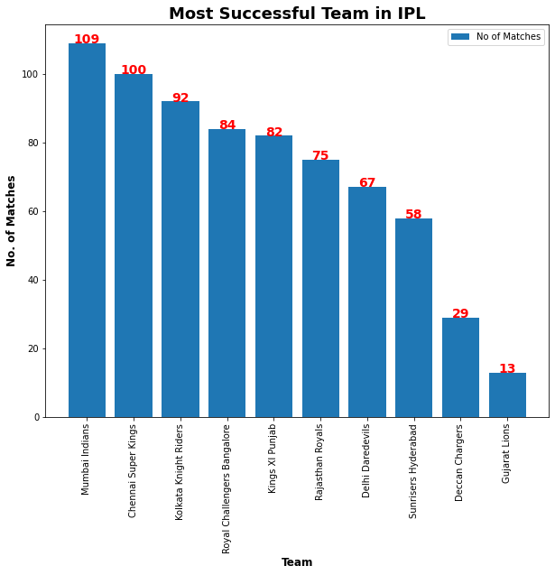

Slide 5
Findings/ Outcome
Batsman with Highest Total Runs scored : Virat Kohli
Batsman with Highest Strike Rate : Andre Russell
Batsman with Most 6s : Chris Gayle
Batsman with Most 4s : Shikhar Dhawan
Batsman with Most Player of the Match award : Chris Gayle
Bowler with Highest Total Wickets : SL Malinga
Wicket Keeper with Highest Total Stumpings: MS Dhoni
Wicket Keeper with Highest Total Catches : KD Karthik
Most Successful Team in IPL : Mumbai Indians
Most Successful Chasing Team in IPL : Kolkata Knight Riders
Contributing Factors for the Win / Lose
Toss win/lose
Home/Away Grounds

Slide 6
Hypothesis Testing - Statistical Verification
Null Hypothesis (Ho) : there is no significant difference between specified and observed values.
Case – 1: Toss Decision has no association with Win/Lose a match
Case – 2: Home ground/Away has no association with Win/Lose a match
Statistical models used
Chi-Square - test association between 2 variables; identifies difference between observed and expected values.
p -value is the probability of observing a test statistic at least as extreme in a chi-square distribution.
One-way Anova - Is an extension of the two-sample hypothesis testing for comparing means (when variances are unknown) to more than two samples
Independent Samples T-test – Identify significant difference between 2 sets of data

Slide 7
Chi-Squared Test
Case-1 : Verify Relationship between Toss Decision and Win/Lose Match
chi square statistic: 7.487898156232028
Critical value: 3.841458820694124
p value: 0.006211501563656352
Significance level: 0.05
Degree of Freedom: 1
chi_square_statistic>=critical_value, So, reject Null Hypothesis (Ho)
p_value<=alpha, So reject Null Hypothesis (Ho)
Result : There is a relationship between toss_decision and win/lose a match
Case-2 : Verify Relationship between Home Ground/Away and Win/Lose Match
chi square statistic: 0.1865617751356011
Critical value: 3.841458820694124
p value: 0.6657937621623271
Significance level: 0.05
Degree of Freedom: 1
chi_square_statistic>=critical_value, So, retain Null Hypothesis (Ho)
p_value<=alpha, So retain Null Hypothesis (Ho)
Result : There is no relationship between team playing in a home ground/away and win/lose a match

Slide 8
One-way Anova Test
Case : Verify if toss decision & team playing on home ground/away has significant impact on "Win/Lose
F-Statistic Value: 73.25316169266804
P-Value: 1.4897896952304592e-31
Result: As p-value<=0.05, reject Null Hypothesis (Ho), toss decision and team playing home ground/away has significant impact on Win/Lose of a match
Independent Samples T-Test
Case 1 : Verify if toss decision has significant impact on "Win/Lose
Ttest_indResult(statistic=3.6458673919367666, pvalue=0.00027553805112149444)
Result: As p-value<=0.05, reject Null Hypothesis (Ho), toss decision has significant impact on Win/Lose of a match
Case 2 : Verify if a team playing on home ground/away has significant impact on "Win/Lose
Ttest_indResult(statistic=8.14361277089045, pvalue=7.980288749273184e-16)
Result: As p-value<=0.05, reject Null Hypothesis (Ho), team playing on home ground/Away has significant impact on Win/Lose of a match

